Slide 1














Active Noise Control
Thimothy Prasanna S
URK22EC4012

Slide 2

Origin of the creative idea
AirPods, with their Active Noise Cancellation (ANC) feature, provide users with a transformative audio experience by intelligently reducing external noise. This technology, known as ANC, has its roots in advanced signal processing techniques and has become increasingly popular in various audio devices.

Slide 3

Project vision and mission
Our project aims to provide immersive and uninterrupted sound environments,where individuals can enjoy their audio content with unparalleled clarity and comfort

Slide 4
Ideation process
01
02
03
04
Begin prototyping your ANC solution using appropriate tools.
(MATLAB)
Design the user interface (UI) for your ANC system
(GUI)
Integrate the selected components into your ANC system
(AUDIO FILES)
Testing and Validation
(OUTPUT)

Slide 5
Creation process
Launch GUI: Opens a window titled "Active Noise Control" with buttons for selecting original audio, noise audio, and applying noise cancellation.
Select Original Audio: Opens a file dialog to choose a WAV audio file for the original audio. Plots the original audio waveform.
Select Noise Audio: Opens a file dialog to choose a WAV audio file for the noise. Plots the noise audio waveform.
Apply Noise Cancellation: Subtracts noise audio from original audio to cancel noise. Plots resulting waveform and plays output audio.
Visualization: Displays original, noise, and noise-cancelled audio waveforms in separate axes.

Slide 6
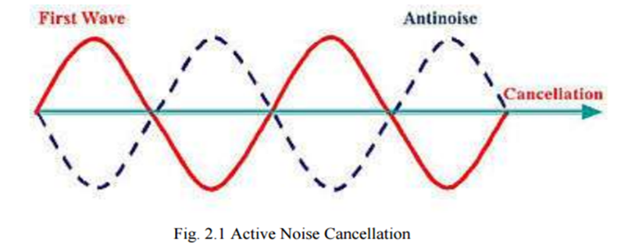
Working
How Noise Cancellation works ?
This is based on the principle of destructive interference, where the noise and anti-noise signals interfere in such a way that they cancel each other out, ideally leaving only the desired signal intact.

Slide 7
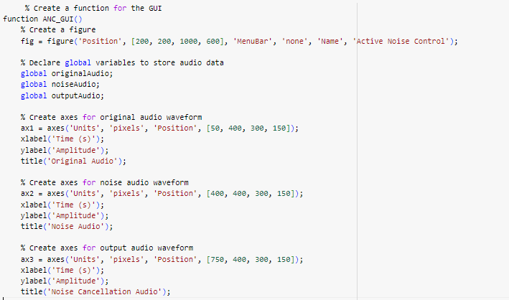
MATLAB code

Slide 8
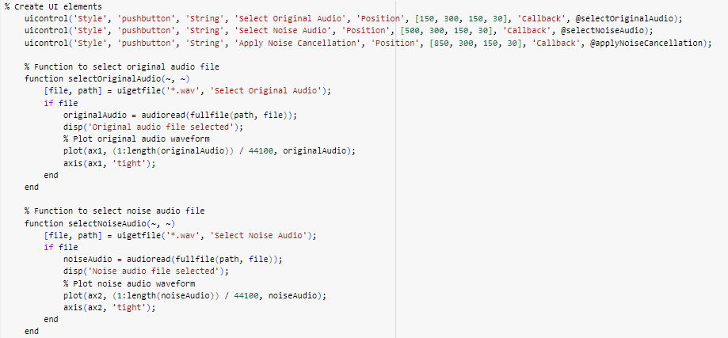

Slide 9
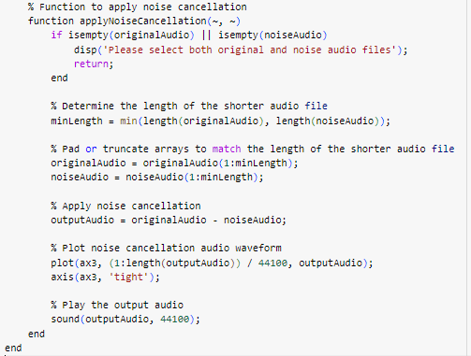

Slide 10
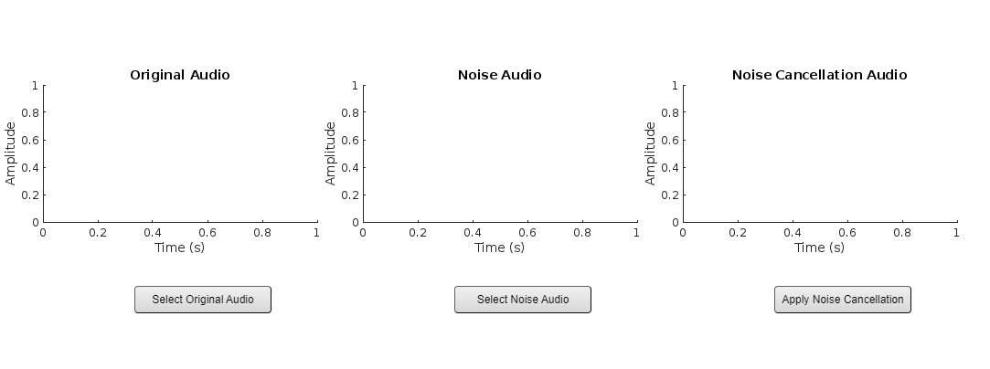
Output
Before Loading Audio files

Slide 11
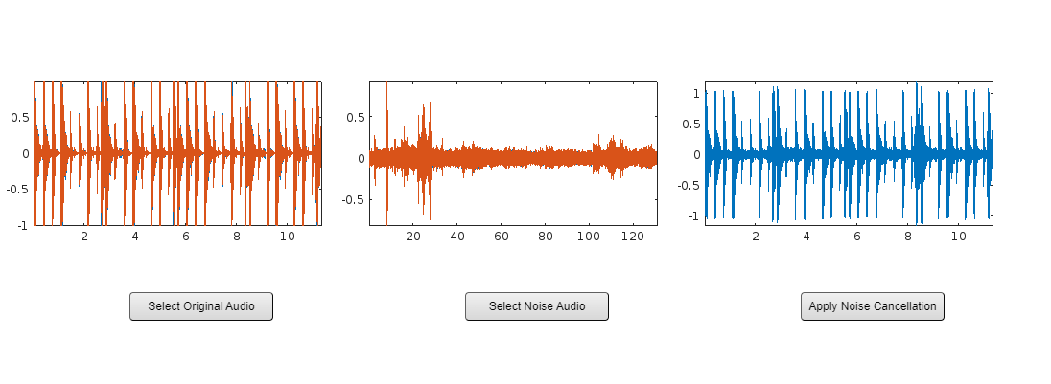
After Loading Audio files

Slide 12
Thank you very much!
https://github.com/Thimothy-06

